Slide 2
OBC – Hot Steep Method
Evaluation of Malt
Tyler Schoales and Mike Heinrich

Slide 3
Agenda
Current Malt Sensory Methods
Overview Of The ASBC Hot Steep Method
Applications For The Craft Brewer
How To Perform A Malt Sensory Evaluation
Malt Sensory Lexicon

Slide 4
Malt Sensory Methods
Overview
Visual
Chew
Congress Mash - Craft

Slide 5
Malt Sensory Methods - Homebrewer
Visual | Chew | Hot Steep Method | Congress Mash
Basic | Basic | Intermediate | Difficult
Notes:
Probably looking at it when you dump it in the mill – right?

Slide 6
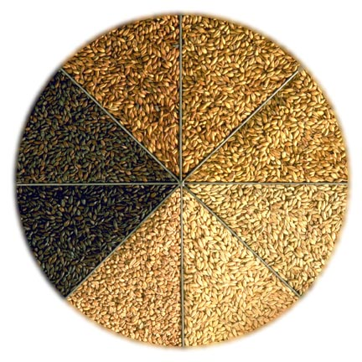
Visual Analysis
Visual
Easy
Color
Foreign Material
Arriving in Good Shape?

Slide 7
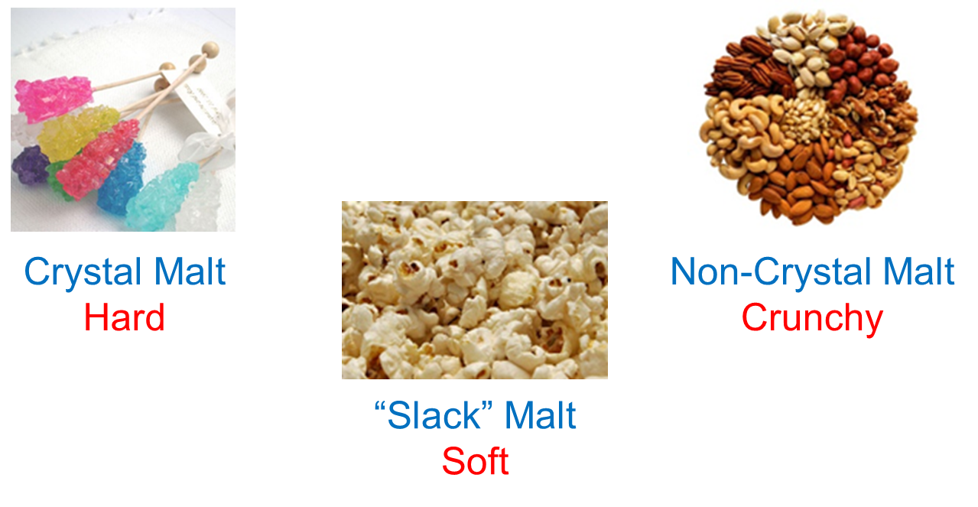
Whole Kernel Chew
Texture
Easy
Color?
Husk
Endosperm
Glassy Malts
Mechanical Action
Physical Traits

Slide 8
Congress Mash - Craft
Need an automated mash bath
50 grams of milled malt
200 milliliters of distilled water
Mash at 45°C and hold for 30 minutes (113°F)
Raise 1°C/minute until 70°C is reached
Hold at 70°C for 60 minutes (158°F) – Iodine test after 5 minutes to confirm starch conversion
Cool to room temperature within 15 minutes
Add distilled water to mash until it weighs 450 grams and stir
Filter through funnel with fluted filter paper into 500 milliliter flask
Pour first 100 milliliters of filtrate back into filter
Collect 200 milliliters

Slide 9
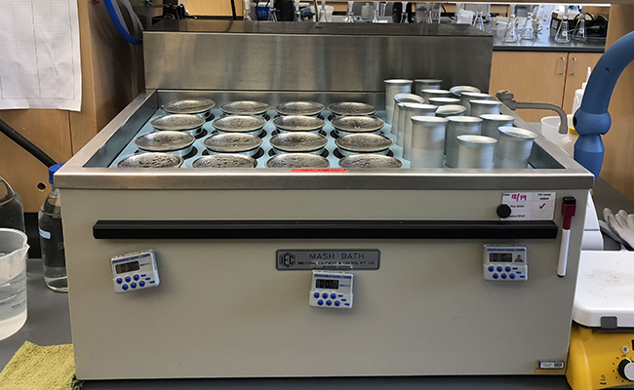
Congress Mash
Designed for MAXIMIM THEORETICAL YIELD from the Malt
Conversion Occurs
Sugars!!!
Typically around 8°Plato

Slide 10
Hot Steep Method
Why?
How?
Equipment
Method

Slide 11
Why Was the Hot Steep Method Developed?
Flavor gap identified by the Brewers Association
Standardization facilitates communication
And
Consistency

Slide 12
How was the method developed?
Developed at Briess
Beta tested by Briess, New Belgium, and Highland
Validated by ASBC Sensory Technical Subcommittee
Validation method developed by Lindsay Barr

Slide 13
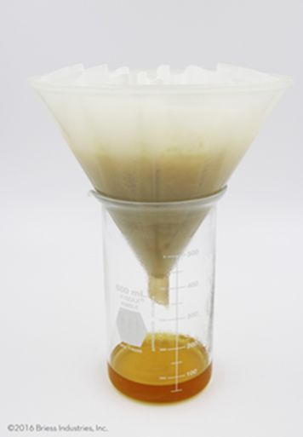
What is the Hot Steep Method?
Rapid wort preparation procedure developed for the sensory evaluation of extractable malt attributes

Slide 14
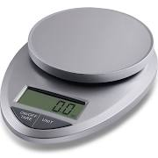
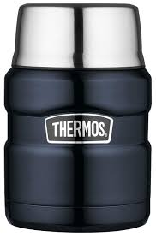
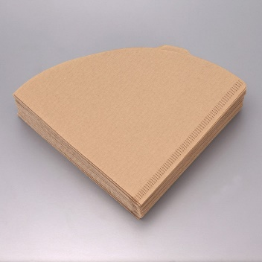
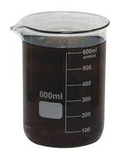
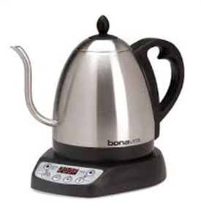
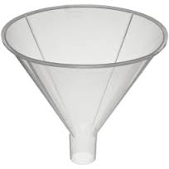
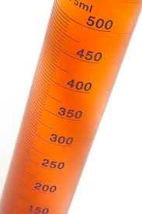
Equipment Required
Supplies can be purchased from a general retailer…
scale
filter paper
insulated thermos
tall glassware
electric grinder
electric kettle (optional)
graduated cylinder
plastic funnel

Slide 15
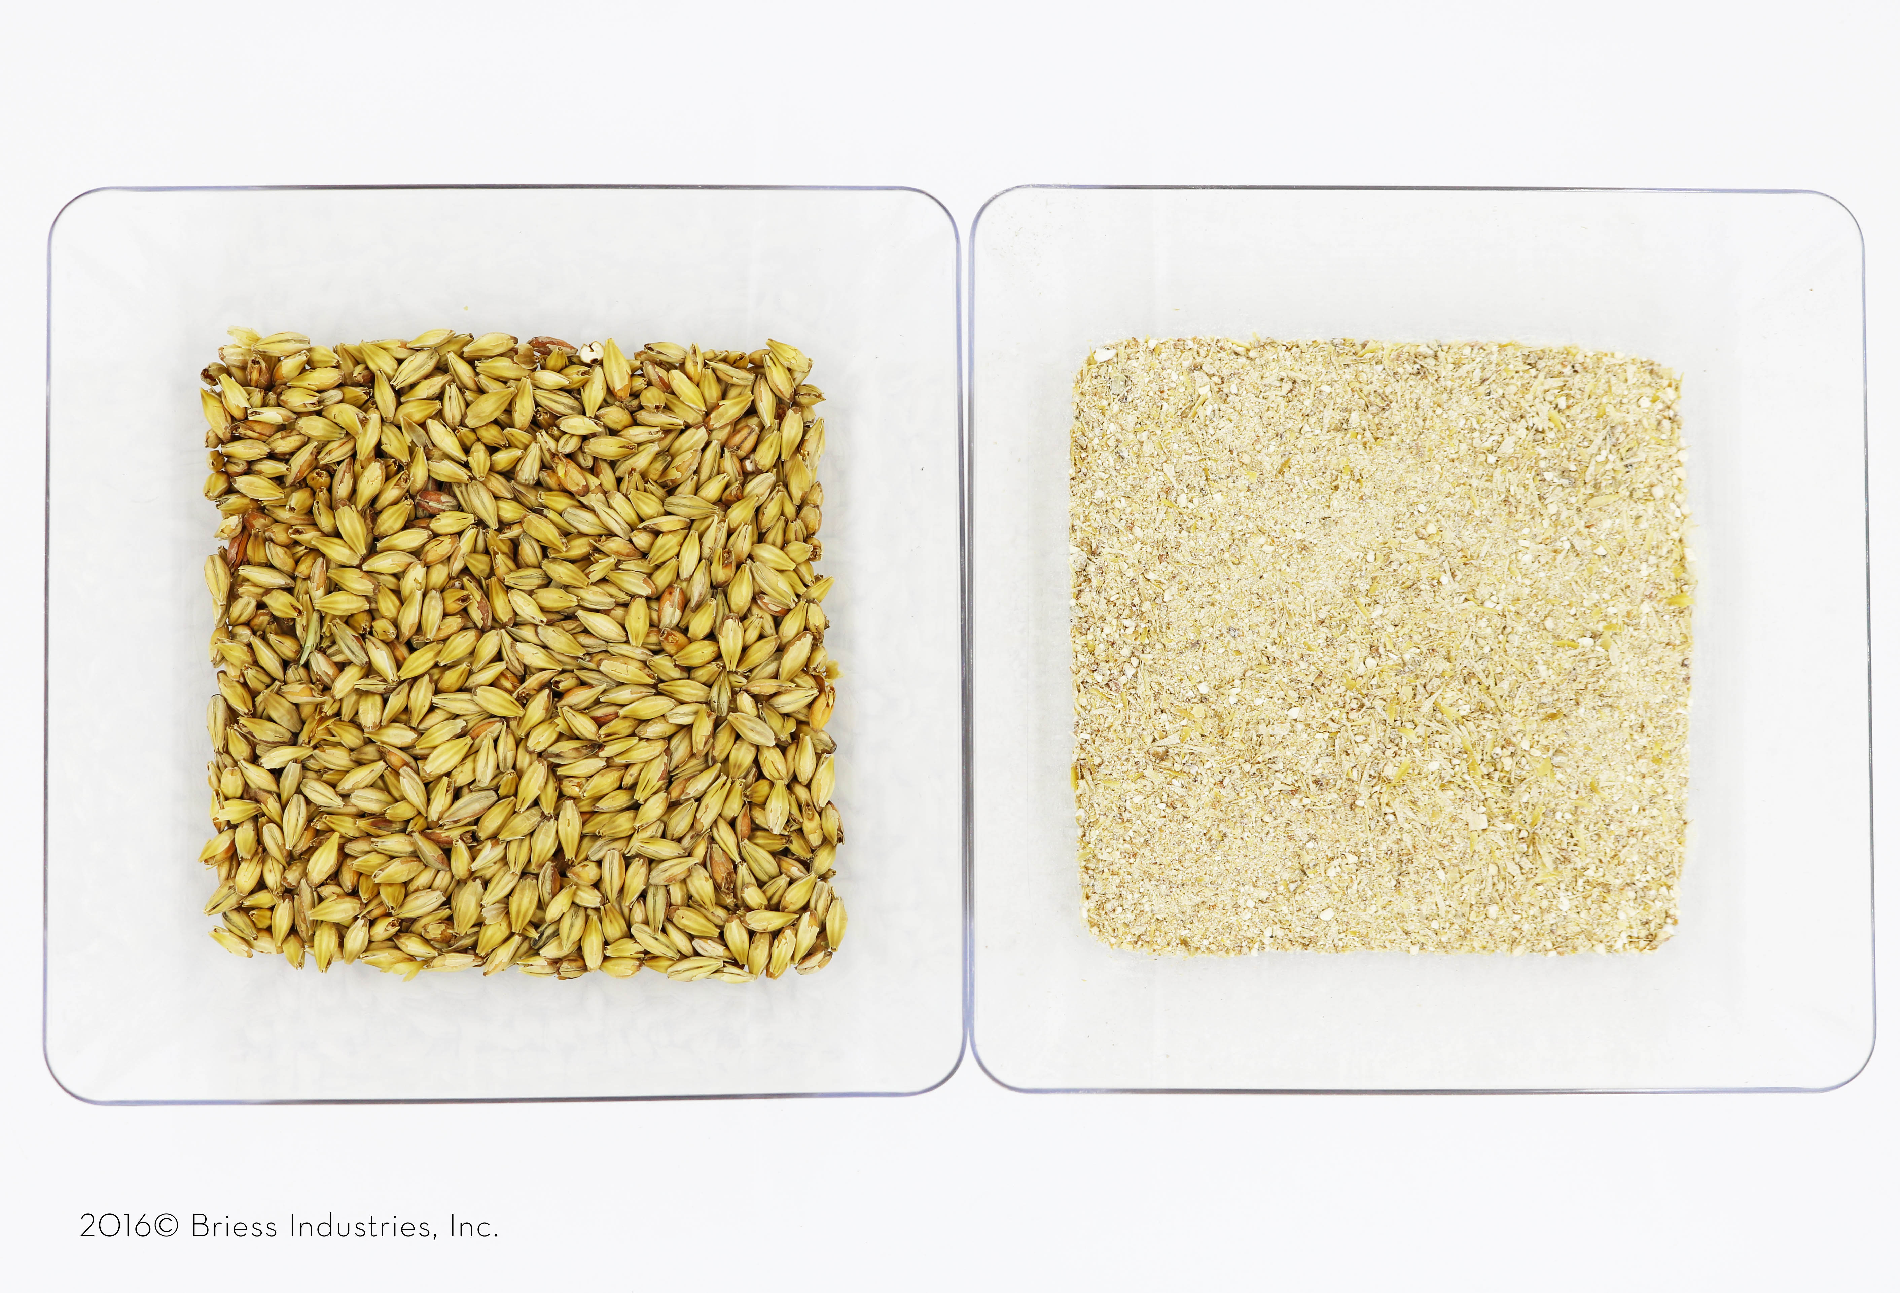
How to Perform The Hot Steep Method
In home demonstration of Hot Steep method
https://www.youtube.com/watch?v=NJWRpihU84Y
Whole kernel vs. ground malt, milled for 10 seconds in electric coffee grinder
Hot Steep wort filtration

Slide 16
Hot Steep Methodology
50 grams of milled malt
Ground to a coarse flour
400 mL of 65°C distilled water
Combine and shake in Thermos – wait 15 minutes
Swirl then filter
Filter through funnel with fluted filter paper into 600 milliliter flask
Pour first 100 milliliters of filtrate back into filter
Collect 200 milliliters
Notes:
65 degrees for 15 minutes – probably much more representative of brewhouse performance.
65 degrees C is about 149 degrees F

Slide 17
Specialty Malt Considerations
Specialty malts with insufficient enzymes
Prepare: 50% sample, 50% base malt
Base malt is used to facilitate conversion and prepare a standard wort that is more relevant to brewing usage rates

Slide 18
Specialty Malt Considerations
Dark Roasted Specialty Products
Prepare: 15% sample, 85% base malt
Base malt is used to reduce the intensity of overwhelming roasted flavor and prepare a standard wort that is more relevant to brewing usage rates

Slide 19
Evaluation
Overview
Visual
Aroma
Taste

Slide 20
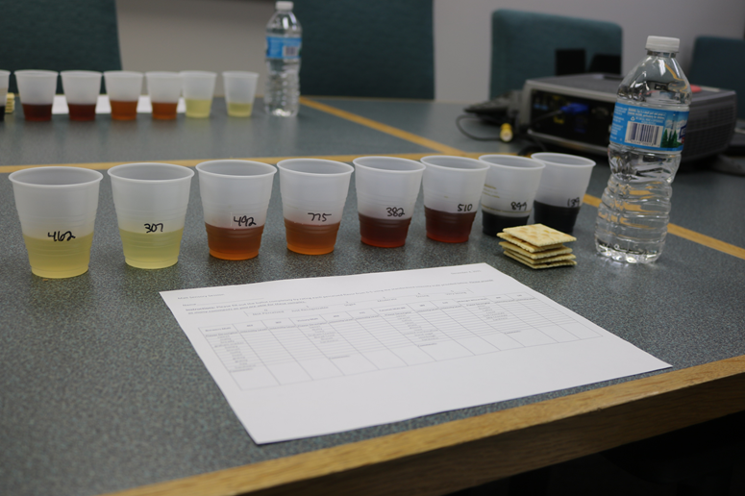
Overview of Evaluation
Clear, plastic cups (less than half full)
Water and unsalted crackers
Evaluate:
Visual
Aroma
Taste
Mouthfeel

Slide 21
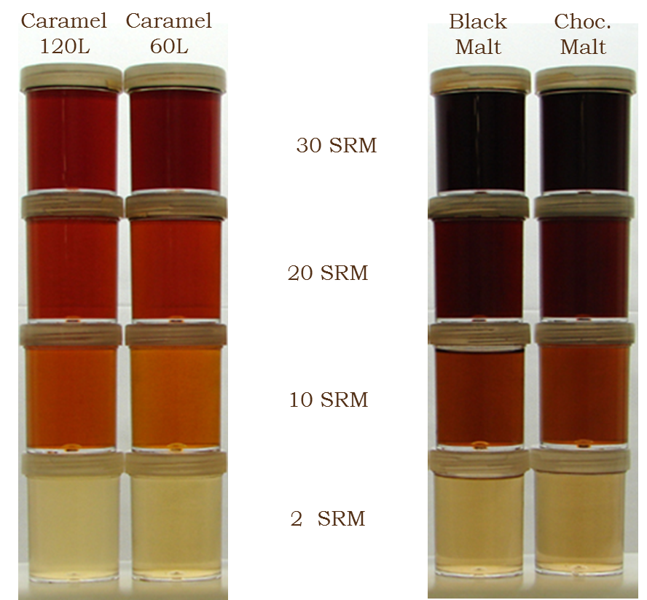
Visual
We look at wort with our eyes to evaluate hue
Lovibond Color ≠ Hue

Slide 22
Aroma
We smell and swallow wort to perceive aroma attributes
Most aromas present in malt result from non-enzymatic browning reactions that occur during heat processing conditions – Maillard Reaction
Raw, starchy, and grassy type flavors can result from lack of processing

Slide 23
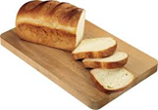
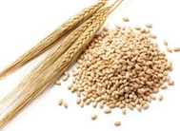
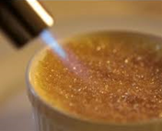
Taste
We swallow wort to evaluate taste:
Sweet
Sour
Salty
Bitter
Umami
Fat
grainy
bready
burnt sugar

Slide 24
Mouthfeel
We swallow wort to evaluate mouthfeel:
Body (thick to thin)
Astringency (low to high)
Cloying (low to syrupy)
Coating (low to slick)
Mouthwatering (low – high)

Slide 25
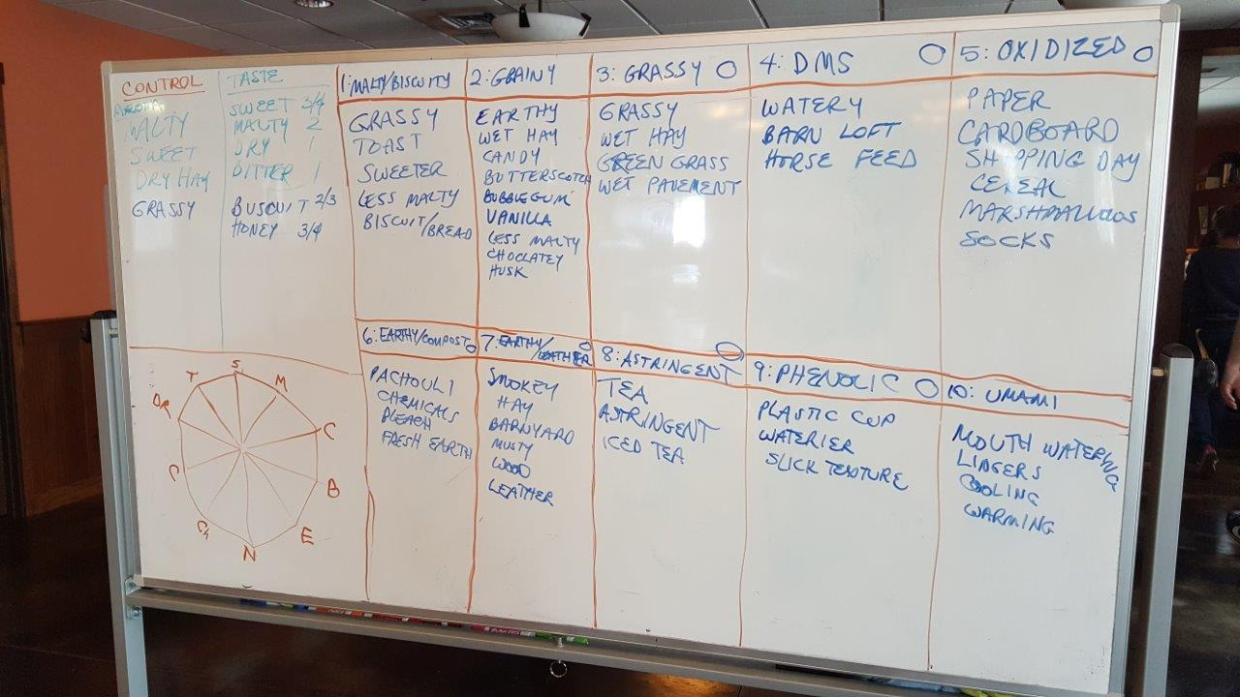
You can’t really begin to describe the sensory aspects of malt without the proper language…

Slide 26
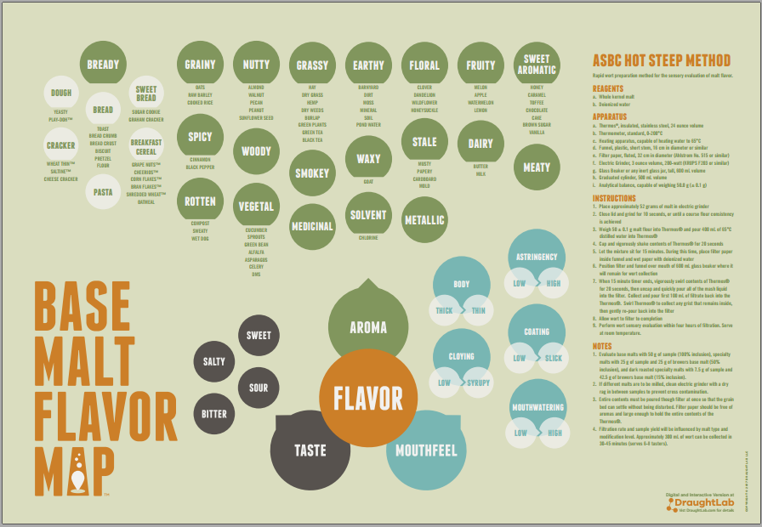
So…A lexicon was created

Slide 27
Questions?

Slide 28
References
Source: “Hot Steep Method – MPK” Killelea, Michael, Briess Malting Company, Chilton, WI, 03/10/2018

