Slide 1
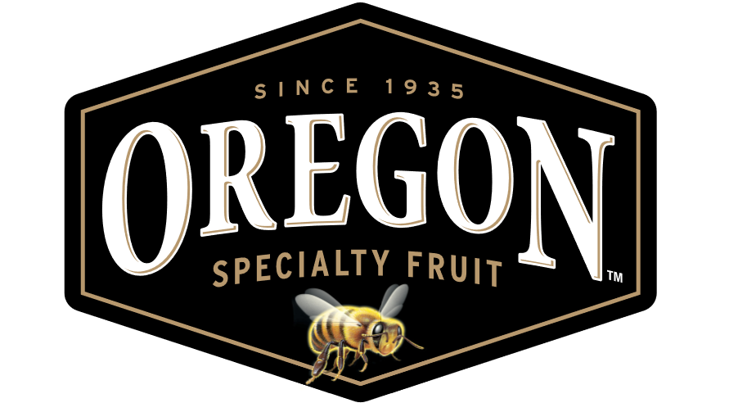
Fruit Innovation for Craft Beverages Oregon Brew Crew Portland May 9th, 2019

Slide 2
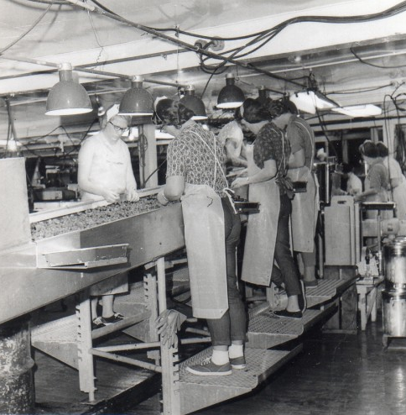
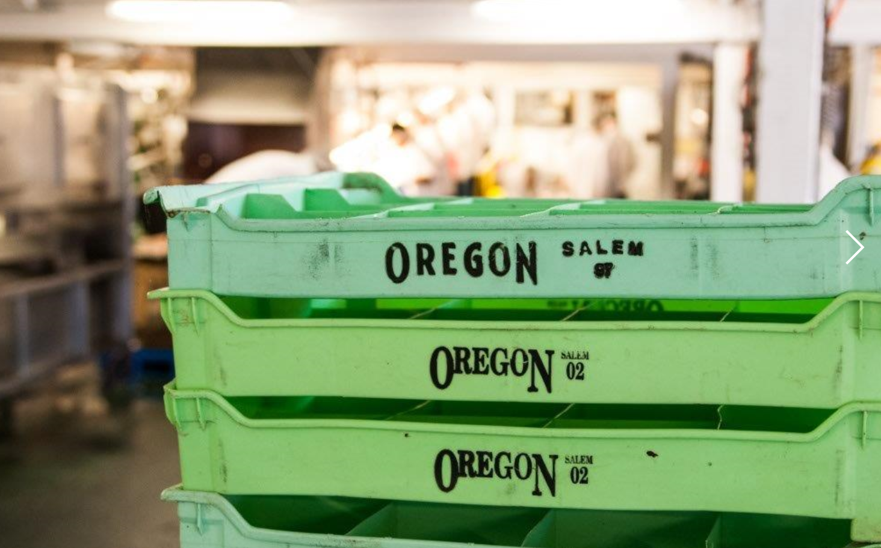
The Oregon Fruit Story
Family owned from 1935 to 2011 and still family owned after being sold to a third generation Oregon based family in October 2011
Showcasing the best of premium fruit, using highest quality production facility to create three distinctly successful channels of business.
Always innovating and continuing to create new channels for growth
Decades of exceptional industry knowledge in Fruit, Food and Beverage

Slide 3
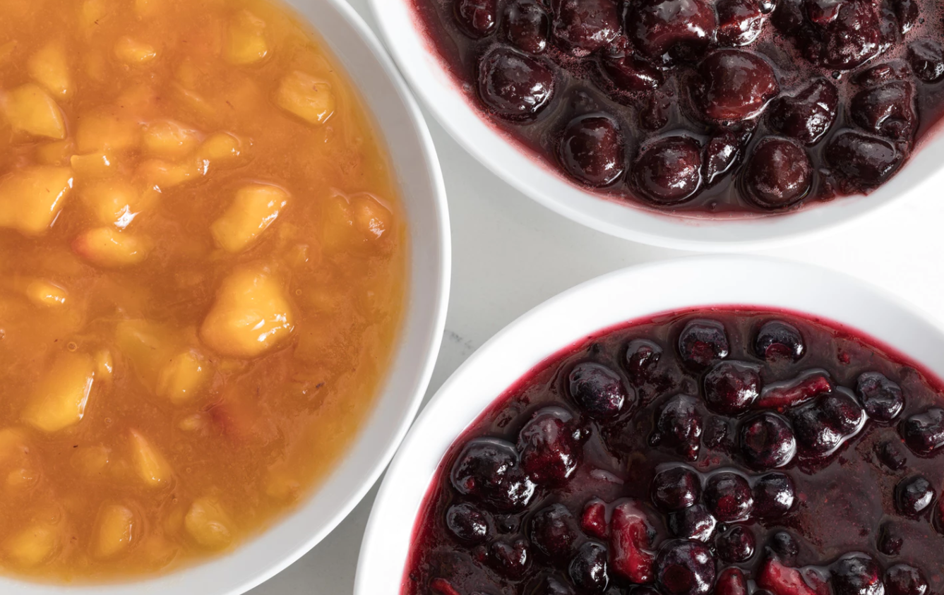
Oregon Fruit Channels of Trade
Retail
The “signature can” Oregon Fruit began with our Black Label cans of specialty fruit
Products are Non-GMO, free of preservatives, Kosher certified and canned with high quality pure cane sugar
National Brand with select international markets
Food Service
A newer part of the OFP portfolio, we began producing the current version of these products in 2006
Simply diced fruit, fruit juice with pure cane sugar, blended together in different formulations for hundreds of food service applications

Slide 4
Oregon Fruit Channels of Trade
Aseptic Puree
Began producing aseptic products in 1986.
New facility and aseptic line activated in fall of 2018.
New Bag and Cap enclosure released in 2019
The aseptic process uses pure, or IQF fruit and juices, which are then processed into a puree form using 7 simple steps:
1)Fruit is washed and put through a finishing screen (remove seeds etc.) 2) Dumped into a kettle 3) Heated to 200F 4) Run through a secondary filter 5. Ran through a cooling tube 6) Into filler head 7)Packaged into aseptic packs

Slide 5
OFP in 2019
Oregon Fruit purees now available in all 50 states and throughout Canada
OFP developing distribution plan with Country Malt Group
Continue plans to grow the Export markets….currently selling to 10 countries
New Seasonal Fruits in 2019 will include 5 new LTOs.
Key Lime was a huge hit …coming back for a guest appearance in June.
First CBC show special…Special Blend of Blackberry Lime….still some left
Next Up? Currently in research mode...Red Currant, Lemon, Kumquat,
Please send new fruit ideas to: chrish@oregonfruit.com

Slide 6
OFP and CMG partnership expands in 2019
New distribution of OFP 42# boxes spans across entire CMG North American territory in 2019.
49 oz. Vintners Harvest cans and Aseptic 42# box products have a different aroma, color, fruit character profile due to additional heat step for can pasteurization.
OFP Purees are now gaining popularity in several New channels of business…Distilled Spirits, Craft Sodas,
Hard Kombucha, CBDs, Natural Hard Seltzers

Slide 7
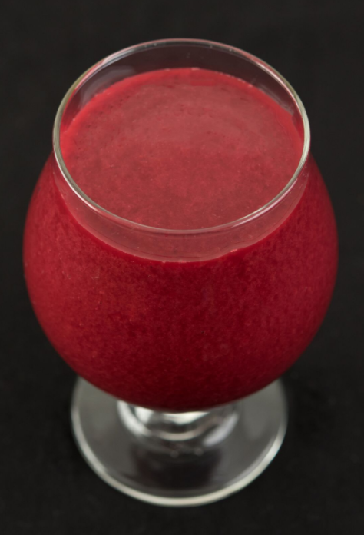
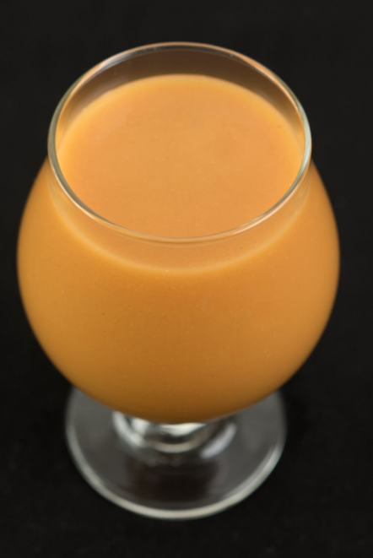
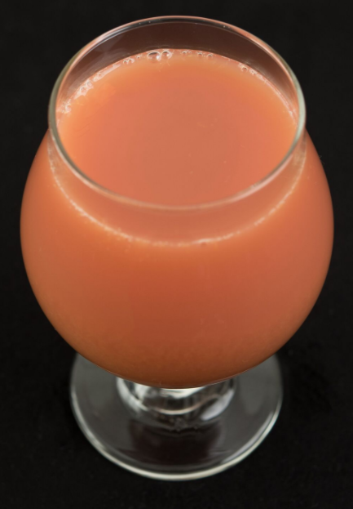
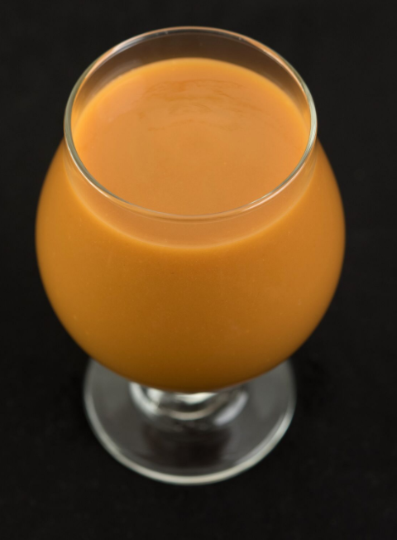
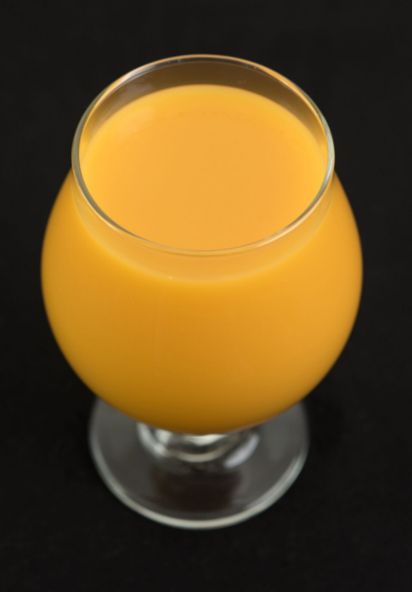
Aseptic Purees….something for everyone
RASPBERRY
PEACH
BLOOD ORANGE
APRICOT
MANGO

Slide 8
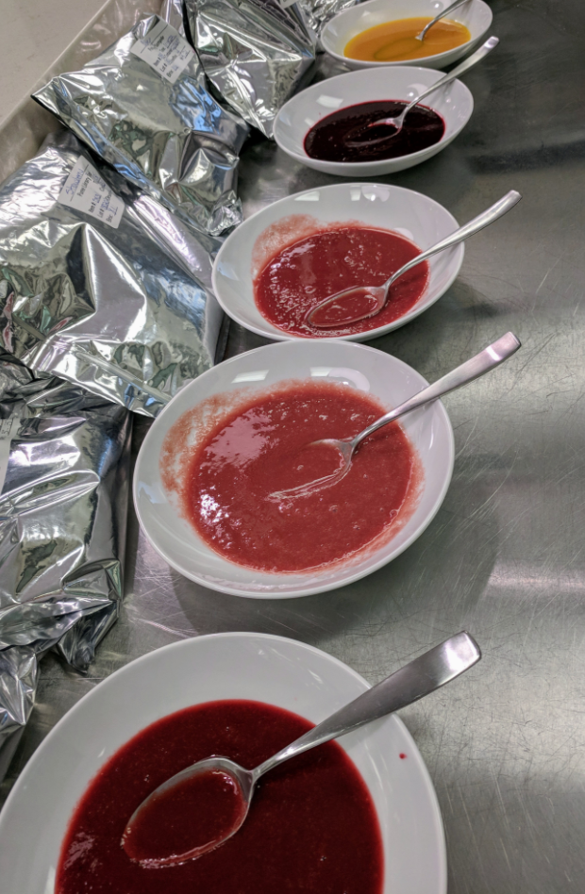
Technical Attributes
Weekly sensory panels to taste every product that is produced at the OFP facility
All production runs sent to 3rd party lab to ensure product meets quality standards.
All incoming fruit must pass strict guidelines prior to being received for production in any OFP product line
Spec Sheets, COAs, COOs all available upon request
Technical aspects found on the COA will include: Brix, pH, and a full check list of microbial assessments.
Shelf stable, commercially sterile, varying shelf life recommendations. Typically 5-18 months depending on the fruit type and the storage conditions.

Slide 9
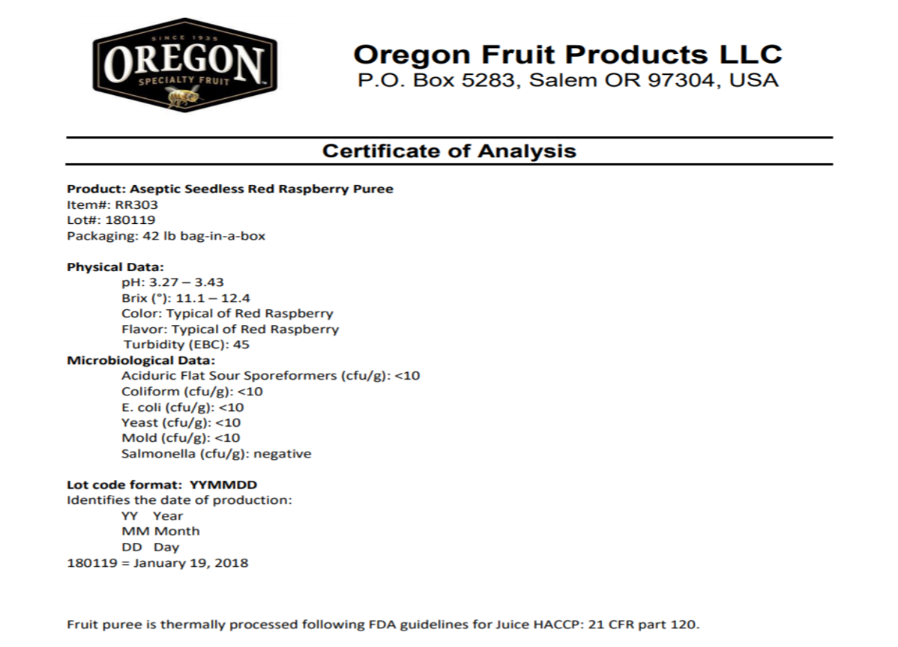

Slide 10
Common Questions from OFP Customers
When should I dose my beer with the fruit puree?
Primary and Secondary are options
What are your top selling fruits?
Rasp/Mango/Blackberry/ Pineapple/Peach/
Recent seaonals: Pink Guava, Pomegranate, Tangerine, Key Lime…All big sellers now year round items
Where is your fruit grown?
How much fruit puree should I use?
Depending on the fruit…0.25 to 2.0 #s per finished gallon of beer.

Slide 11
Top questions to ask brewers
What is the base beer?
What is the yeast strain?
What is the hop bill?
When are you planning to dose the fruit? During Primary, Secondary or both?
Will the beer be package, draft or both?
Will the beer be fined, filtered or centrifuged?
What is the desired fruit character in the finished beer?

Slide 12
What Oregon Fruit does well…
Brings Fruit Innovation to Fermentation Produces Highest Quality Products Builds Strong Partnerships Provides Excellent Customer Service
Thank You….Cheers!

